Slide 1
The Next Step

Slide 2
The solution to homelessness is housing.
Everyone is housing ready.
Housing First is the key.
Notes:
Anchored home set the community goal that the solution to homelessness is housing, and that Anchorage is a housing first community.

Slide 3
New Approach to Housing
The biggest barrier to housing in Anchorage is finding affordable units. What if the system bought its way into the market?
What if landlords received supports along with people experiencing homelessness?
What does that look like?
THE NEXT STEP homelessness is housing.
Notes:
Even in a tight market, there are units available and resources and strategies to unlock those units, Gap of nearly 2,500 in early 2023; we know it has grown since then

Slide 4
The time is right!
Anchorage has:
Nationally recognized public-private housing partnership.
Street outreach.
Improved data collection.
Emergency cold weather plan that includes a groundbreaking focus on housing.
Notes:
Anchored home also gave us the guidance of how to build that coordinated approach to not just provide services, but to collectively reduce the rates of homelessness and collectively increase the rates of people stably housed. The core principles include data driven, person centered housing focused, track performance, and course correct. PDCA

Slide 5
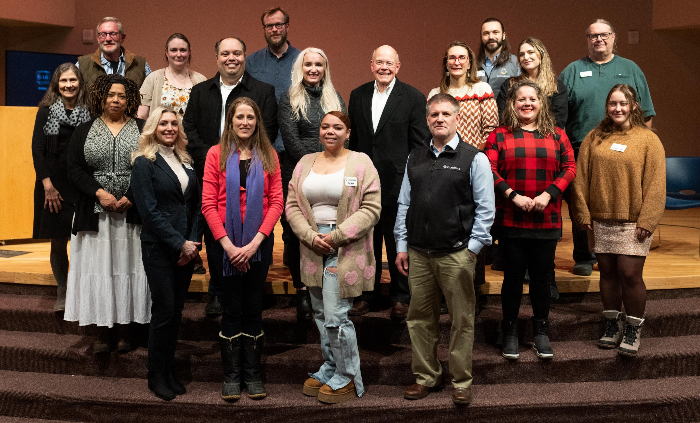
Team members from the Anchorage Coalition to End Homelessness, Municipality of Anchorage leaders and Houston, Texas, visitors gather after a community conversation in December 2023.
Collaboration and partnership can drive down homelessness.
Notes:
Anchored home also gave us the guidance of how to build that coordinated approach to not just provide services, but to collectively reduce the rates of homelessness and collectively increase the rates of people stably housed. The core principles include data driven, person centered housing focused, track performance, and course correct. PDCA

Slide 6
Next Step aims to house
150 people
by the end of Emergency Cold Weather Shelter.
Housing First is not housing only:
Case management for up to 12 months.
Planning for month 13 begins now.
Connection to community resources.
Notes:
Anchored home also gave us the guidance of how to build that coordinated approach to not just provide services, but to collectively reduce the rates of homelessness and collectively increase the rates of people stably housed. The core principles include data driven, person centered housing focused, track performance, and course correct. PDCA

Slide 7
Next Step in action: More housing means less need for shelter
Our financial model is the all-in cost for housing 150 individuals.
$100 a day
Per person cost for shelter
$85 a day
Average per person
cost for housing and supports in Next Step

Slide 8
Equity: Shift to person-centered approach that identifies inequities in the housing system.
Funding: Braided and leveraged funding to support housing.
Coordination: Working with partners to identify high priority individuals as well as assets and barriers to housing.
Housing: An acquisition strategy that works with landlords to identify units and provide supports.
Supportive Housing: Streamlined process to access permanent supportive housing.
Support Services: Diversified funding and a case management strategy to overcome workforce challenges.
The Foundation for the NEXT STEP

Slide 9
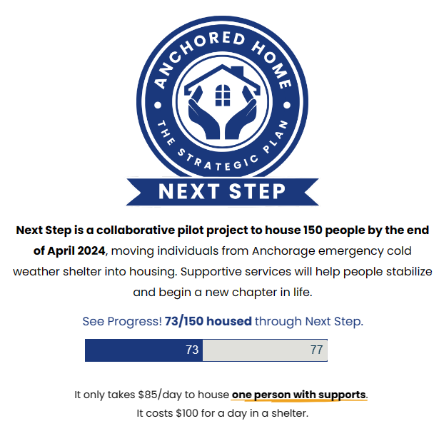
Progress as of 3/18/24

Slide 10
The Next Step – By the Numbers
As of February 28, 2024
Case Management Contracts - 2
Private Landlords Leased - 14
Couples Housed - 14
Pillows - 146
Clients with Individual Resources - 28

Slide 11
Measuring Success
Number of People Experiencing Homelessness In Anchorage
October 2023 – 3,569
January 2024 – 3,460
Percentage of Exits to permanent housing destinations
January 2024 – 36.9%
Pilot Project Returns to Homelessness
Zero

Slide 12
What’s Next?
Second by name list
Continue to recruit landlords
Preparation for Phase 2 this summer
Solicit support for the continuation of the project

Slide 13
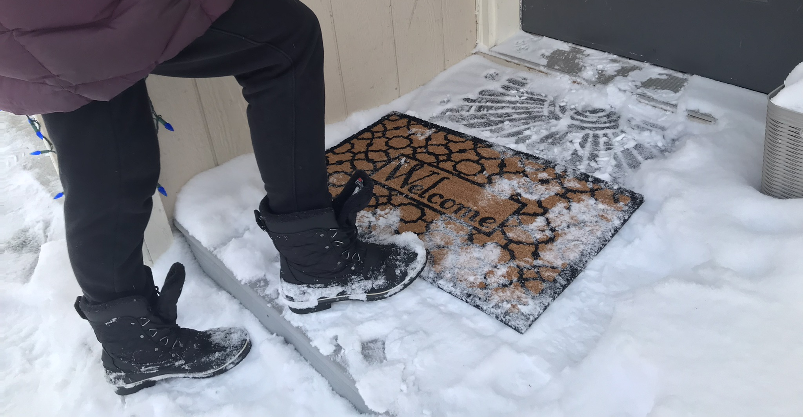
Want to help?
Join us in taking the NEXT STEP!

Slide 14
The Coalition is seeking:
Housing units at market rate. Landlords, connect with Jessica Parks, jparks@aceh.org.
Donations of items for move-in kits. See the wish list and drop off food and new household goods at 3427 E. Tudor Road, Suite A.

Slide 15
Thank you for your interest
in NEXT STEP!
Everyone deserves a safe home.
Learn more: aceh.org/next-step

