Slide 1
HUD Programs and the HHAND Commission
HHAND Commission, March 6, 2024

Slide 2
Presenter
Jed Drolet, Community Systems Program Manager

Slide 3
HUD Planning and Programs

Slide 4
Qualitative Data
Required Plans
5-year Consolidated Plan
Annual Action Plan
Consolidated Annual Performance and Evaluation Report (CAPER)

Slide 5
AHD Programs Covered by Con Plan
CDBG: Community Development Block Grant
HOME: HOME Investment Partnerships Program
ESG: Emergency Solutions Grant
HTF: National Housing Trust Fund

Slide 6
Funding Amounts
Program Year | CDBG | HOME | ESG
2023 | $1,872,494 | $773,536 | $166,518
2022 | $1,894,631 | $778,755 | $163,790
2021 | $1,948,478 | $748,644 | $155,133
2020 | $1,818,770 | $723,361 | $151,146
2019 | $1,720,154 | $663,207 | $146,461

Slide 7
Sample Projects

Slide 8
Community Development Block Grant – Recent Projects
RurAL CAP
Mobile Home Repair
Alaska Literacy Program
Building Upgrades
Alaska Women’s Aid in Crisis
Harmony House Upgrades
Covenant House Alaska
Bridges to Success (Micro-Units)

Slide 9
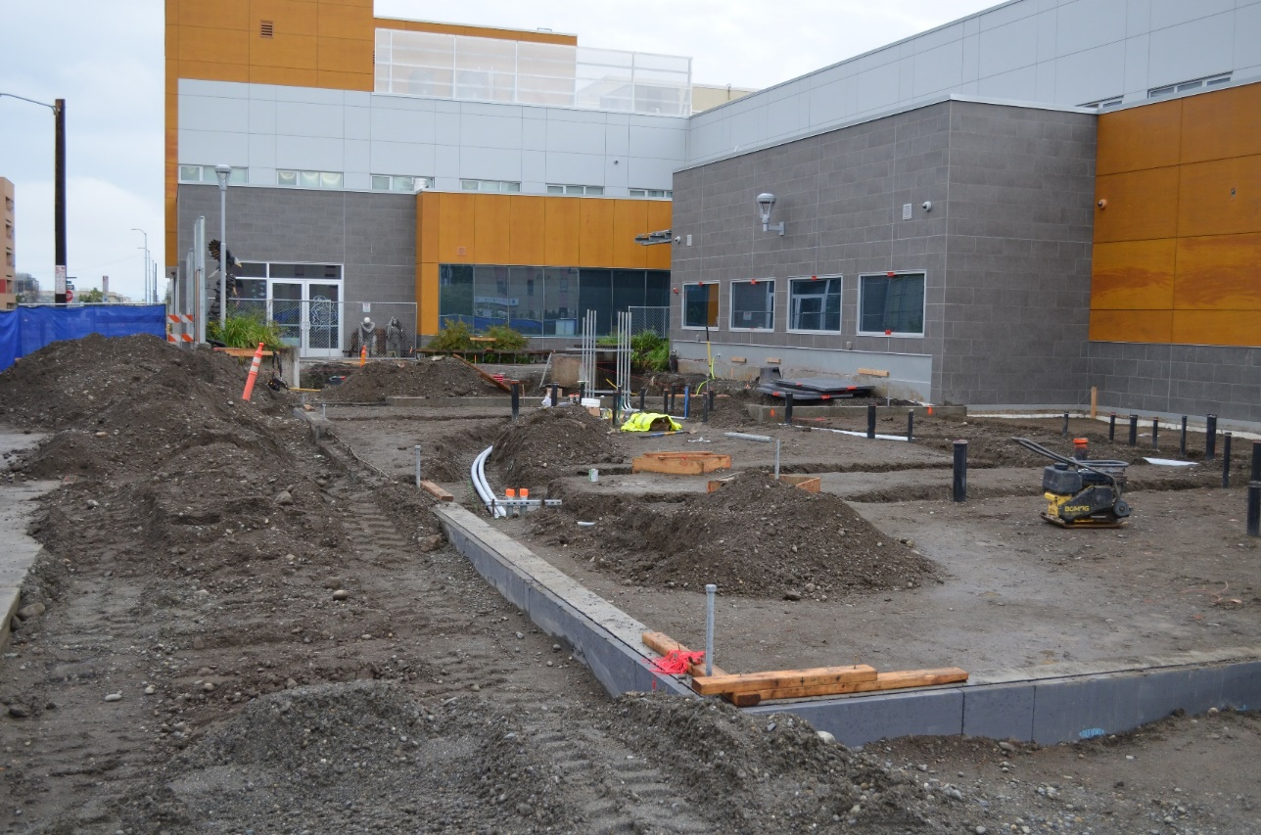
Community Development Block Grant – CHA Bridges to Success

Slide 10
Community Development Block Grant – Recent Services
Alaska Legal Services Program
Legal assistance to those at risk for homelessness
RurAL CAP
Homeless case management
Nine Star
Net2Ladder program

Slide 11
HOME Investment Partnerships – Recent Projects/Services
Habitat for Humanity
Homebuyer Development Program (Duben Ave.)
NeighborWorks Alaska
Tenant-Based Rental Assistance
Cook Inlet Housing Authority
Elizabeth Place
Duke’s Downtown

Slide 12
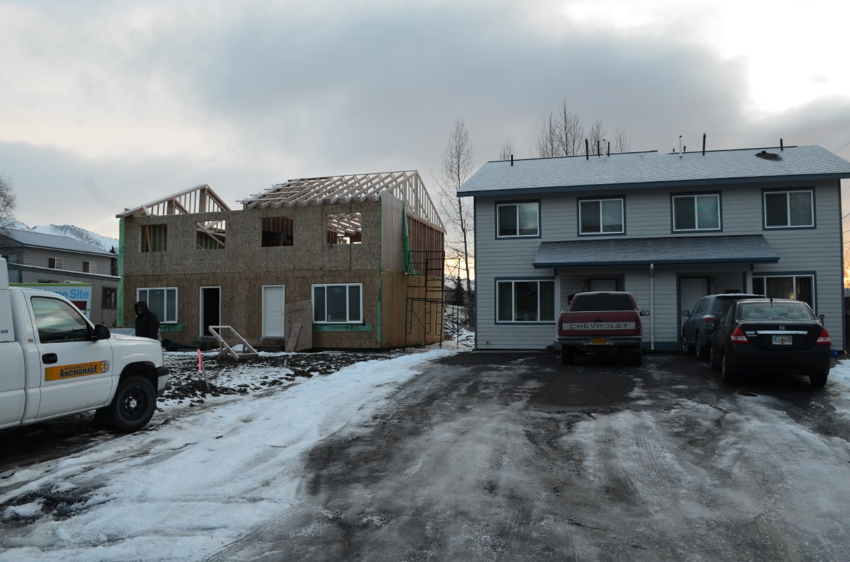
HOME Investment Partnerships – Habitat for Humanity Duben Ave.

Slide 13
Emergency Solutions Grants – Recent Programs
Aging and Disability Resource Center
Catholic Social Services
Institute for Community Alliances
Homelessness Prevention
Rapid Re-Housing
Homeless Management Information System Lead Activities

Slide 14
Consultation
HHAND Commission
ACEH/CoC
Federation of Community Councils
Individual Community Councils
Social Service Agencies
AHFC
Any other interested organization

Slide 15
HHAND Commission History

Slide 16
HHAND Program History
1993: Anchorage Housing Commission
1997: Housing and Neighborhood Development (HAND) Commission
2004: HAND Commission Oversight Subcommittee on Homelessness (HCOSH)
2017: Housing, Homelessness, and Neighborhood Development (HHAND) Commission

Slide 17
Anchorage Housing Commission
Established by Assembly in 1993 (Mayoral Veto Overridden)
“[T]o advise the Mayor and the Assembly on issues related to long- and short-term housing in the Municipality”
11 members
Minimum of “four citizens who will represent our neighborhoods, consumers and residents directly affected by the housing situation in our municipality”

Slide 18
HAND Commission
Established by Assembly in 1997 (Mayor in Support)
“[T]o advise the Mayor and the Assembly on issues related to long- and short-term housing and community development needs in the Municipality of Anchorage, and strategies to effect revitalization of lower-income and at-risk neighborhoods”
11 members
Minimum of “four citizens representing lower-income neighborhoods”
Citizens who experience disabilities
Representatives of real estate, banking, nonprofit housing orgs, homebuilders, shelter providers

Slide 19
HCOSH
Established by Assembly in 2004 (Mayor in Lead)
Subcommittee of HAND with overlapping membership
To “advise the commission, the Mayor, and the Assembly on issues related to homelessness”
5 members, 2 from HAND Commission (increased to 13)
Include members representing the homeless, nonprofits, public safety, business, school district, government, faith community, neighborhoods, or charities

Slide 20
HHAND Commission
Established by Assembly in 2017 (Mayor in Support)
Merger of HAND and HCOSH
“[T]o advise the Mayor and the Assembly on issues related to long- and short-term housing, homelessness, and community development needs in the Municipality of Anchorage, and strategies to effect revitalization of lower-income and at-risk neighborhoods”
9 members
4 members representing the homeless, nonprofits, public safety, business, school district, government, faith community, neighborhoods, or charities
Remainder: people experiencing disabilities, representatives of real estate, banking, multi-family development, nonprofit housing, homebuilders, or supportive housing providers

Slide 21
Roles of the HHAND Commission
Review and make recommendations on allocation of federal, state, and municipal funds for housing and community development
Identify and address long- and short-term housing and homelessness issues
Advise mayor and assembly on policies, practices, and legislation affecting housing and homelessness
Participate in development and implementation of Con Plan and coordinate with Continuum of Care on homelessness plan

Slide 22
Questions?

Slide 23
Thank you!
Contact info: Jed Drolet Anchorage Health Department
(907) 343-4285
Jedediah.Drolet@anchorageak.gov

